Slide 1
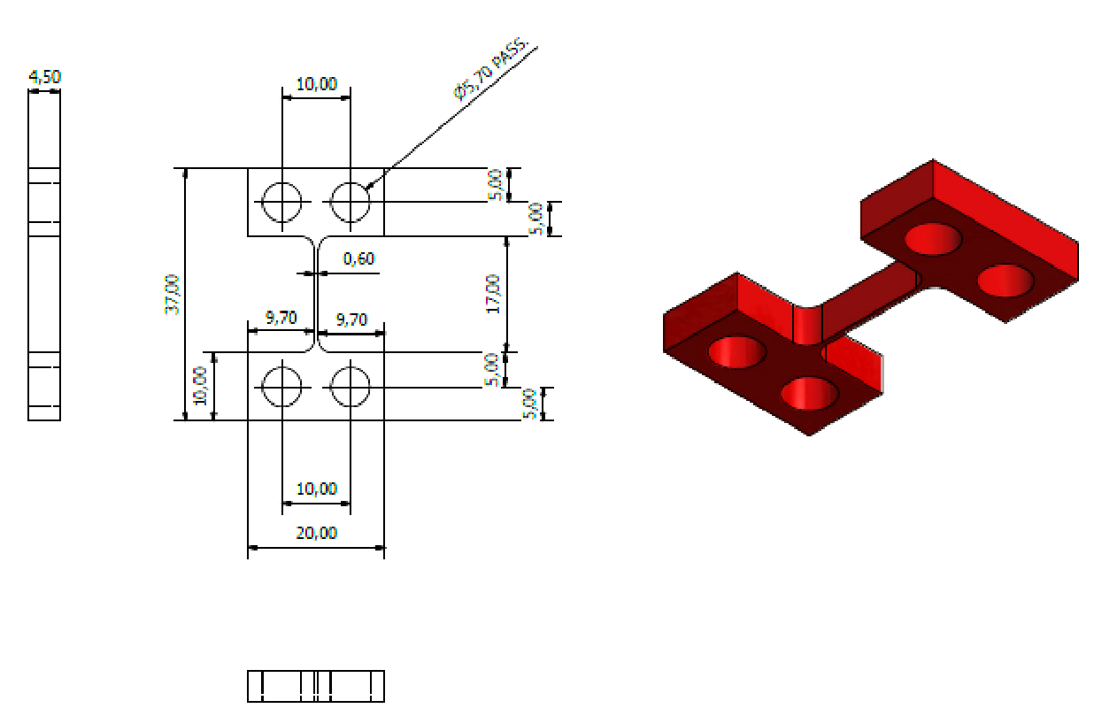
V3DJoint
Phys. Lab II - Mid Term Report
05/05/23
Measurement of the Quality Factor of flexible joints
Alessandro Mazza, Danilo Ricciardella, Victor Sanz Sanchis, Davide Quaranta

Slide 2
Why Flexible Joints?
Elastic joints are often used in experiment to build sensors
Accelerometers
Displacement sensors
Tiltmeters etc…
In particular, in a GW detector thermal noise is important and can be reduced by lowering the temperature of the suspended mirrors
Therefore performing joints at cryogenic temperatures are needed
Goal :
Testing performance of 3D printed metal joints
Comparing with standard production techniques

Slide 3
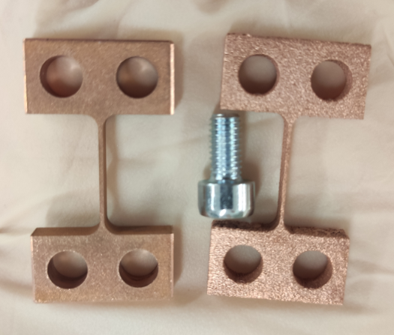
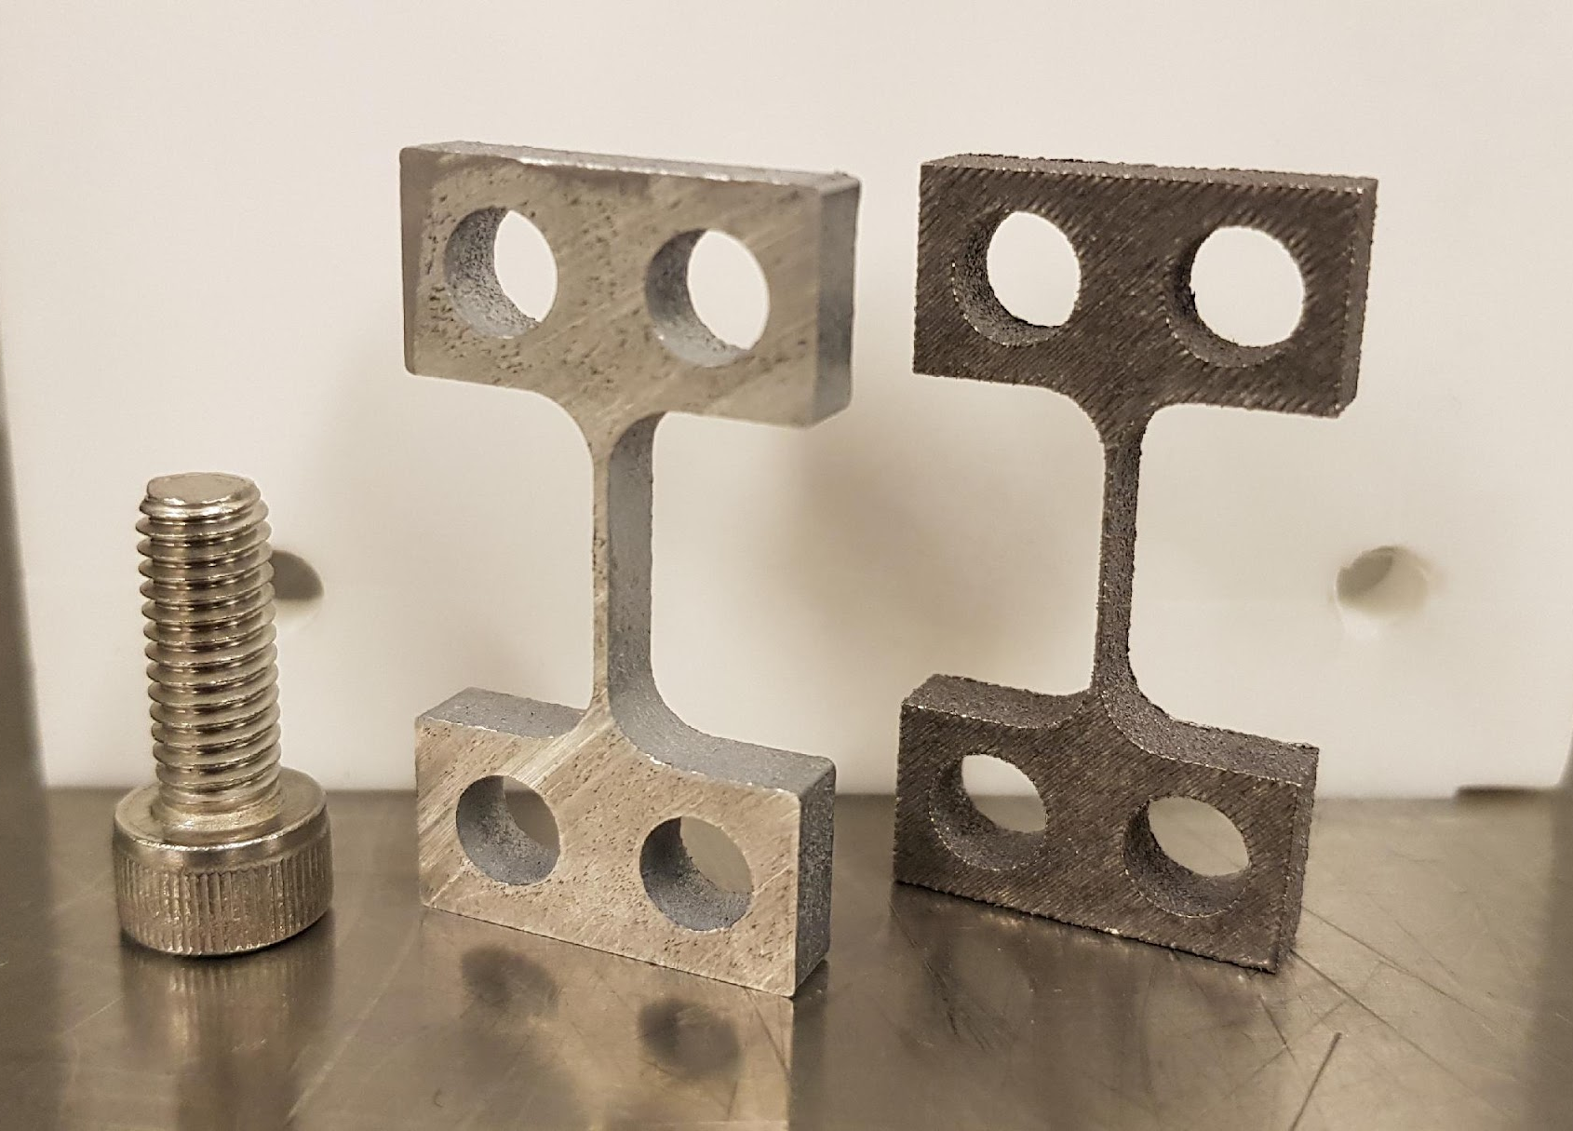
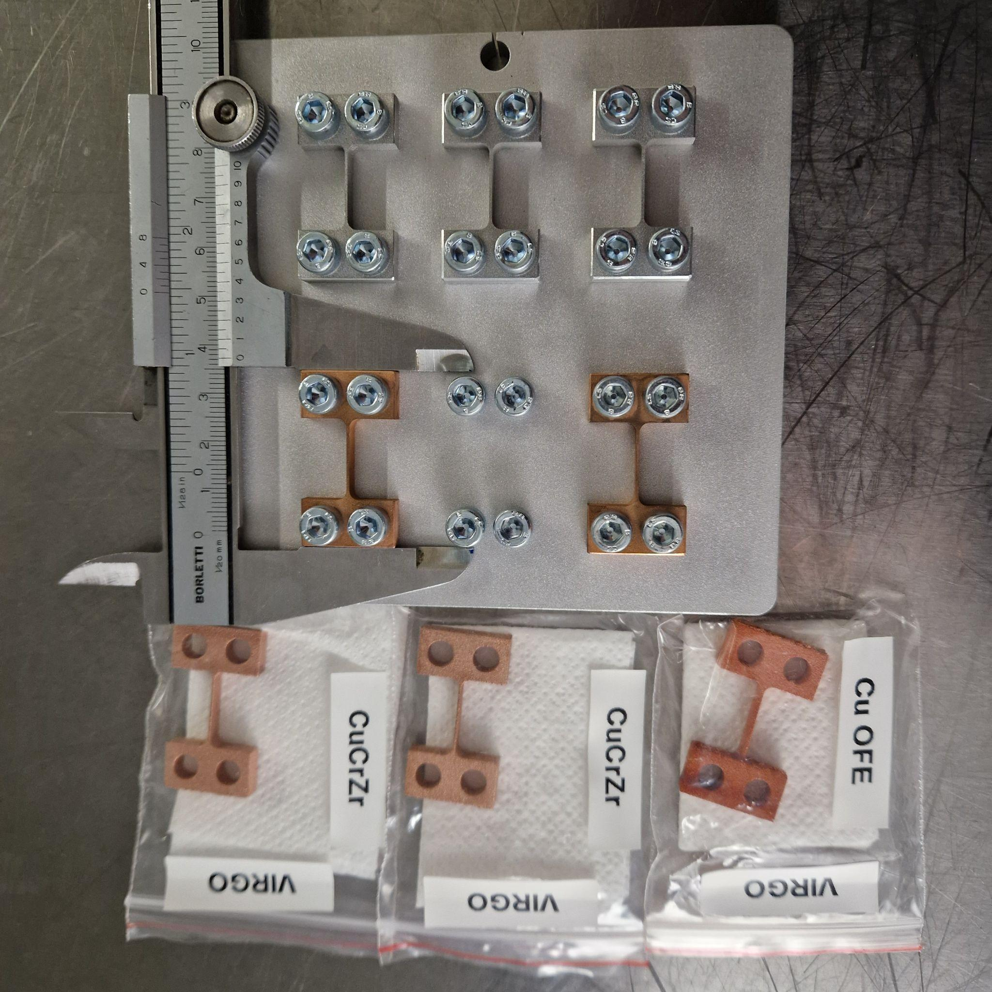
Why Flexible Joints?
3D Printed
Electroerosion
Tested
To be Tested
To be Tested
Copper-Chromium-Zirconium (CuCrZr)
Aluminum-Silicon-Magnesium (AlSi10Mg)
CuCrZr and AlSi10Mg

Slide 4
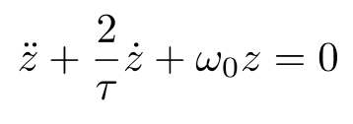
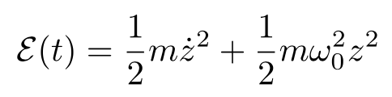

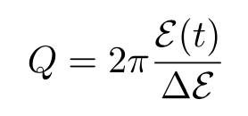
Theoretical model
The joint acts like a damped harmonic oscillator and has the following differential equation:
Finding the expression for the position and the velocity, the energy stored in one oscillation can be calculated:
The oscillation is governed by the angular frequency ⍵ and one cycle is completed in a period T = 2𝜋/𝜔, so the energy lost per cycle
Now the quality factor (Q) can defined as 2π times the ratio of the energy stored in one oscillation over the energy lost in a cycle:

Slide 5
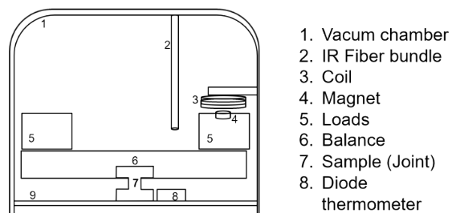
Experimental Setup & Procedure
Bring the chamber to a certain T with the help of a cryocooler Pulse Tube
Kick the balance by sending a current through the magnet
Measuring displacement with laser sensor
Fourier Transform through Spectrum analyzer
Measure the decay time of first harmonic
Fit to find 𝜏
Compute Q
x(t) = Ae^{-t/𝜏}cos(𝜔t + 𝜑) → Q = 𝜋𝜏𝑓

Slide 6

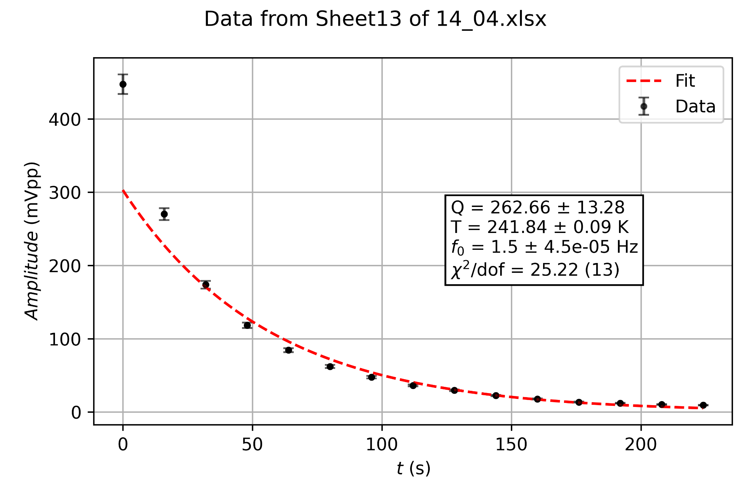
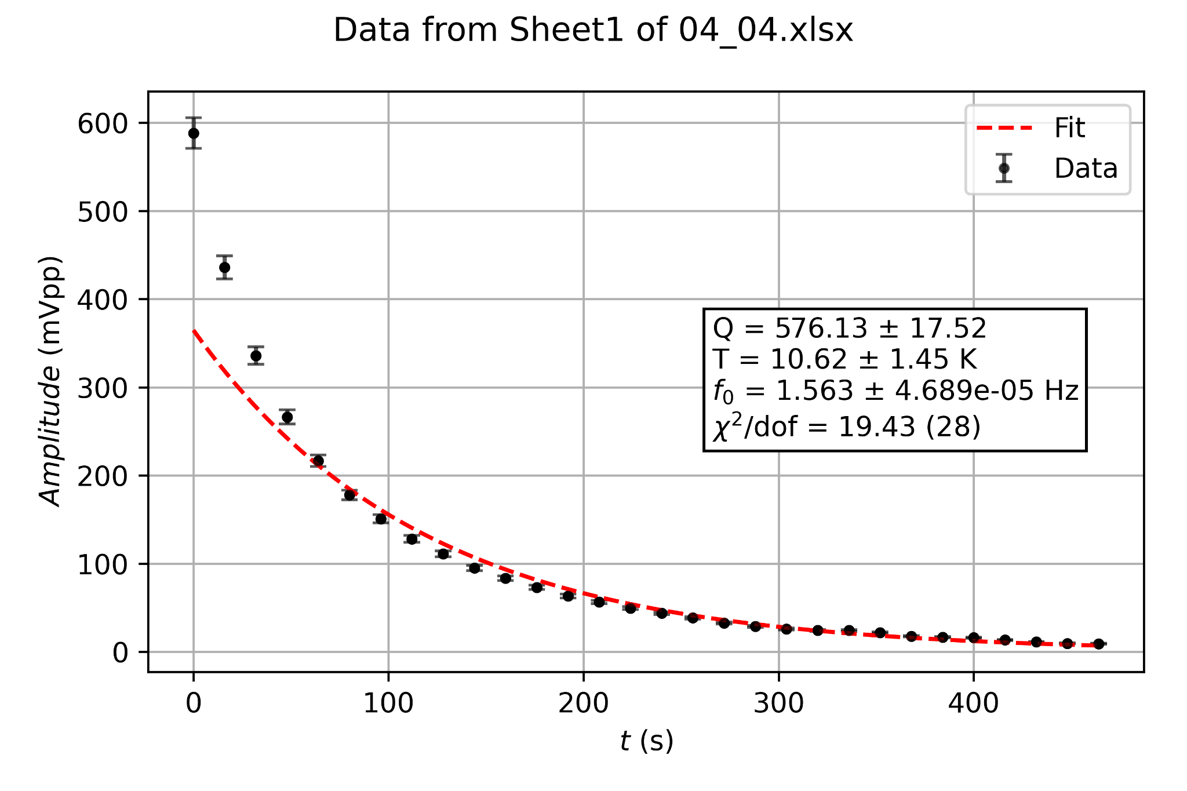
Experimental Setup & Procedure
Observing the amplitude decay we’re able to extrapolate 𝞽 and calculate
Oscillation amplitude decay for f=1.5Hz at T=241.8K
PLOT QVST
Oscillation amplitude decay for f=1.563 Hz at T=10.6K
Sample: Copper-Chromium-Zirconium (3D printed)

Slide 10
Consideration (?)

Slide 11
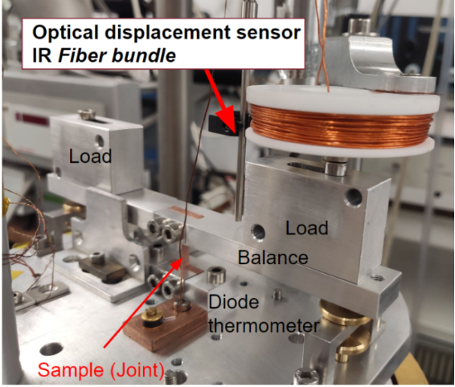

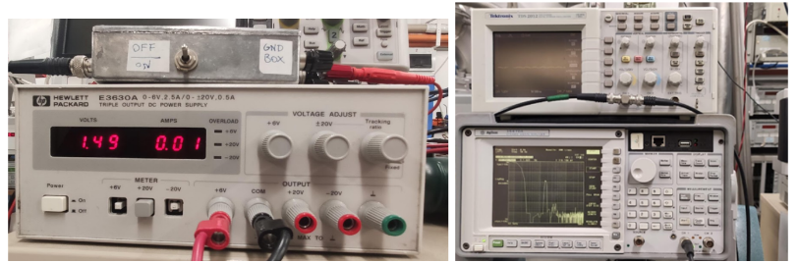
Experimental setup
Pulse tube crycooler connected to a helium compressor;
Fiber bundle;
Thermometer;
Coil and magnet;
Generator;
Signal analyzer;

Slide 12

Alluminum-Silicon-Magnesium alloy (AlSi10Mg) Samples
Copper-Chromium-Zirconium alloy (CuCrZr) Samples
CuCrZr and
AlSi10Mg
samples also produced by electroerosion (standard process) at Virgo for comparison with 3D printed samples

